Slide 1
Project Name : Object Tracking with CAMShift Algorithm
Group Name: Machine Learning-12
College: Poornima University
Submitted By: Anisha Yadav(MCA-1st yr)
Tridev Singh Rao(Btech-Data Science, 4th yr)
Fardeen khan(BCA-Data Science, 3rd yr)
Rajat Jain(BCA-Data Science, 3rd yr)
Aastha Sinha(BCA-AI & PA, 3rd yr)
Rishabh Asoj(MCA-1st yr)

Slide 2
Object Tracking with CAMShift Algorithm
Estimate the Position of the Object even when the object sizes are changing as they move closer to or farther from the camera.
To deal with problems such as image noise, distractors, irregular object motion due to perspective.
Objective

Slide 3
What’s New?
Computationally Efficient- working in real-time
Fast processing
Irregular Object motion detection(linear/non-linear)
Robust to distractors(e.g. other objects)
Robust to background-foreground color
Robust to image noise

Slide 4
Target Audience
Traffic Monitoring & Vehicle Navigation
Motion based Recognition
Automated Video surveillance
Drone Controls

Slide 5
Technologies Used
CAMShift ( Continuously Adaptive Mean Shift )
Open CV
YOLO V3 Object Detection
Python

Slide 6
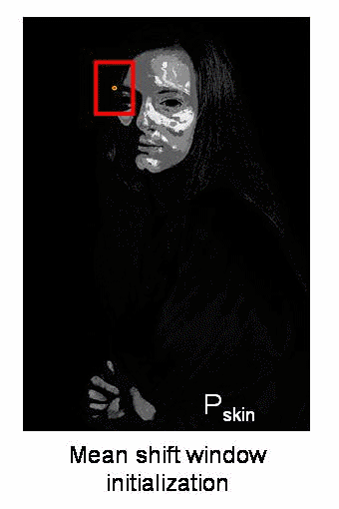
Project Demonstration

Slide 7
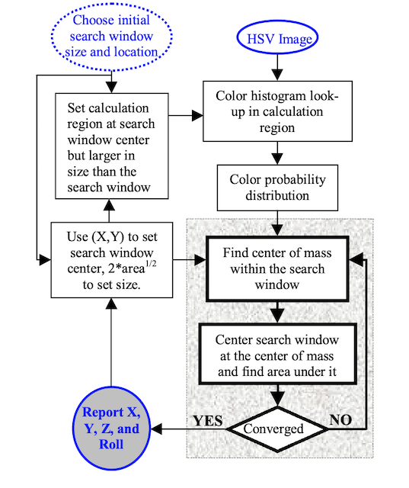
Block diagram of CAMShift

Slide 8
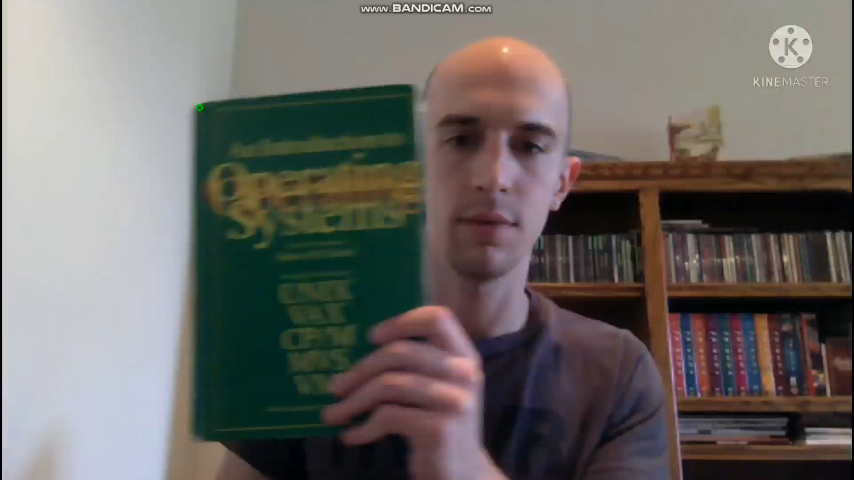

Slide 9
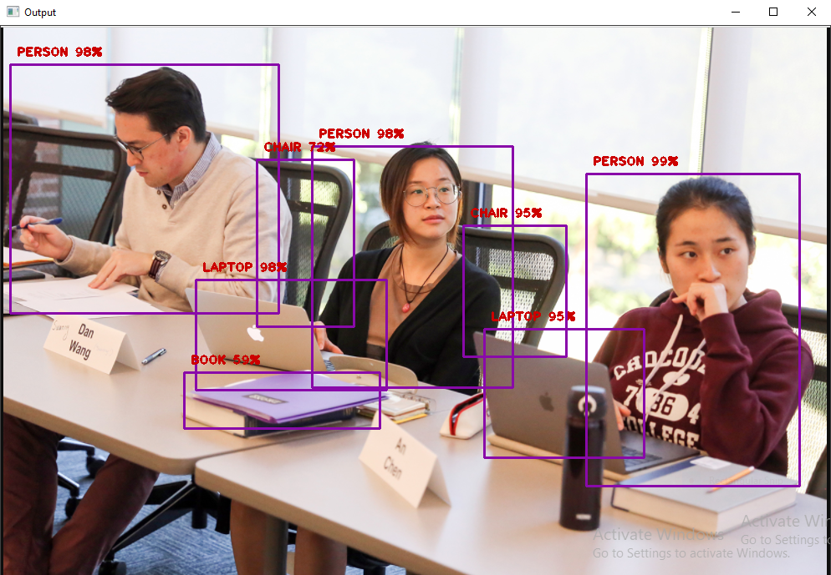

Slide 10
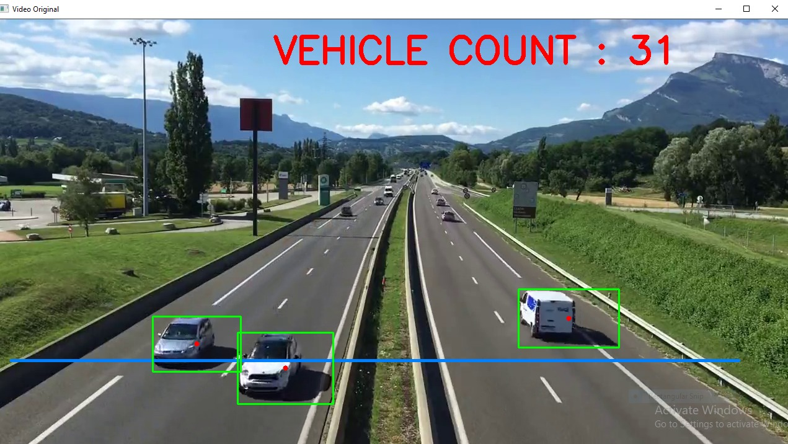

Slide 11
Future Scope
We can extend the code to compute a 2D histogram using both the Hue and Saturation components whereas currently we are only using the Hue component of the HSV color space.
Implement new model for Multi-Object tracking
The algorithm is tested and verified for a set of videos.
As future work the algorithm should be tested/verified for indoor/outdoor videos with strong shadows and partial/full occlusion of objects.
Our future work will integrate shape features with colour to achieve a robust tracking in face of lighting changes and occlusion.

Slide 12
Conclusion
In this project we use the CAMShift algorithm to track objects in the video and YOLOV3 model to detect objects in images.
The Algorithm use color and motion features.
The CAMShift approach is quite powerful for object tracking, especially when you consider we are only utilizing color histograms.
One of the major limitations of the standard CAMShift variant is that it cannot track the desired target when the background (or an object nearby) is of the same colour.
This algorithm has been improved over the years to try to cope with this limitation but, to take into account the structural features of the image, other approaches, such as HOG (Histogram of oriented gradients) ) have been developed. However, nowadays better results can be achieved using deep learning.

Slide 13
Thank You

